Slide 1

AI Infrastructure
Ioannis Papapanagiotou
Understanding AI Infrastructure

Slide 2
Objectives
Students completing this module will be able to explain the motivation behind AI Infrastructure, how it is used today and the technical components.

Slide 3
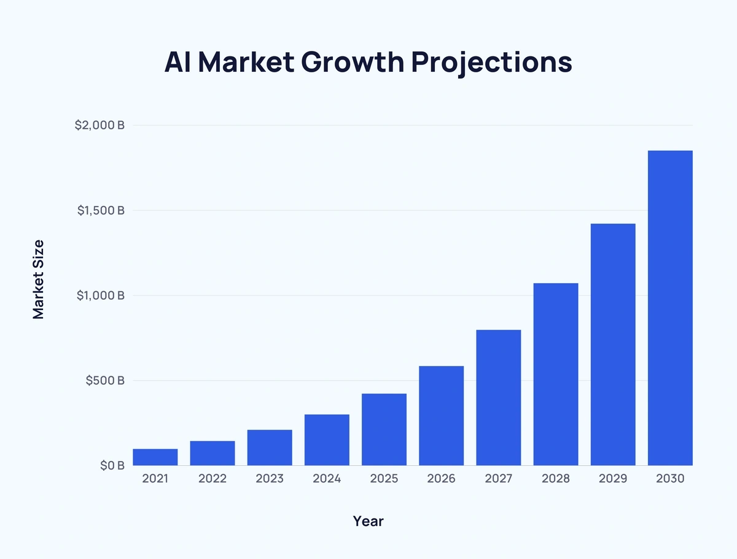
AI Market Growth

Slide 4
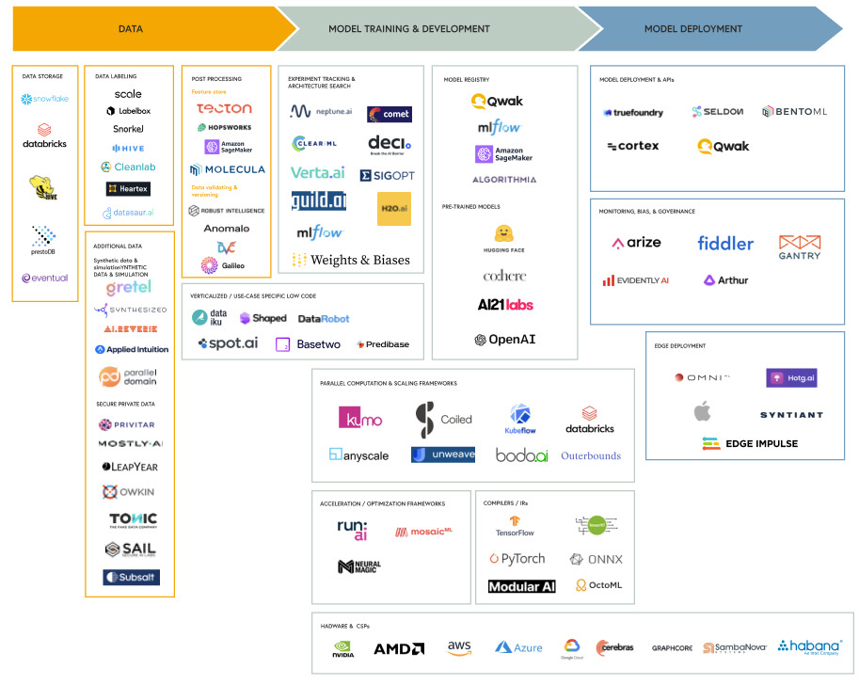
Prominent Players

Slide 5
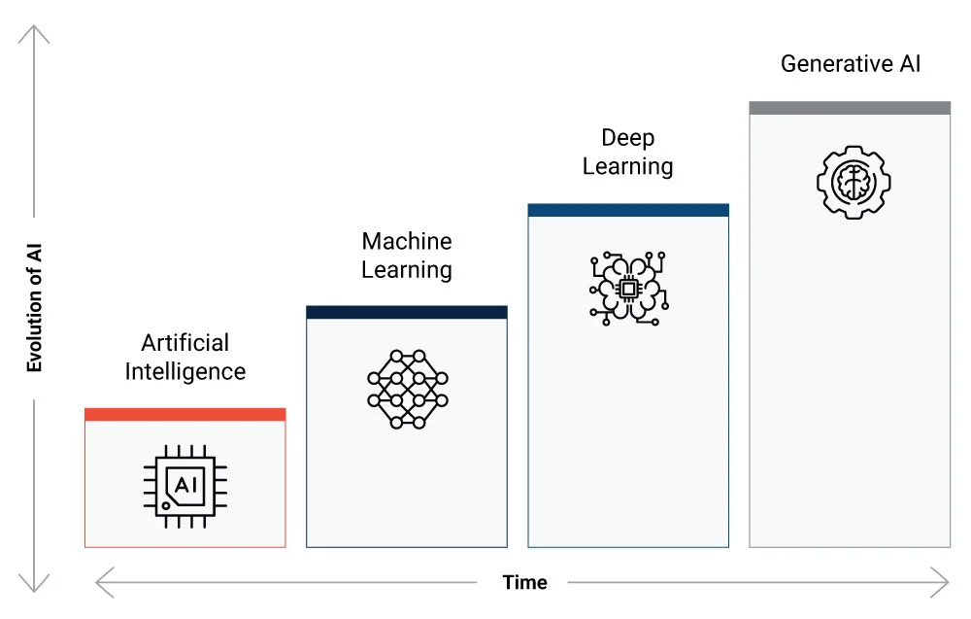

Slide 6

AI is broadly defined as the ability of machines to mimic human behavior. It encompasses a broad range of techniques and approaches aimed at enabling machines to perceive, reason, learn, and make decisions.
AI can be rule-based, statistical, or involve machine learning algorithms. Machine learning, Deep Learning, and Generative AI.

Slide 7
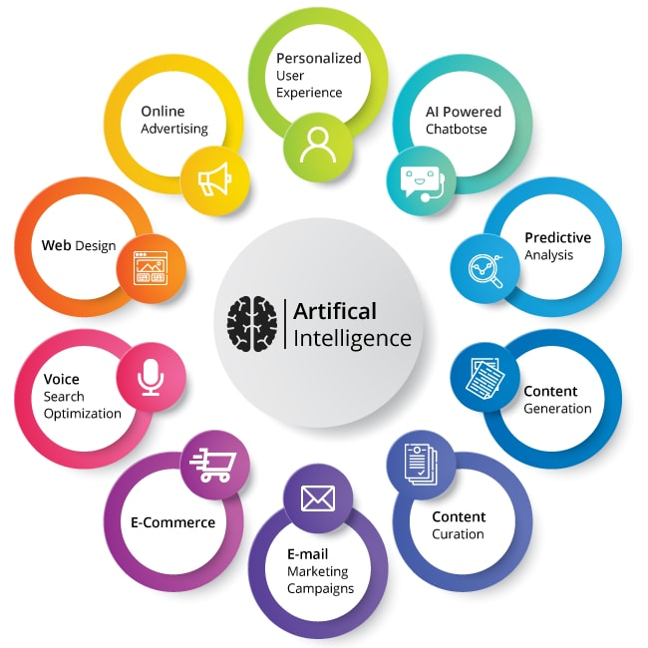

Slide 8
Common Applications of AI
Virtual Assistants: AI-powered virtual assistants like Siri, Google Assistant, and Alexa provide voice-based interaction and assistance to users.
Healthcare Diagnosis and Imaging: AI can assist in diagnosing diseases, analyzing medical images, and predicting patient outcomes, contributing to more accurate diagnoses and personalized treatment plans.
Virtual Reality and Augmented Reality: AI can be used to create immersive virtual and augmented reality experiences by simulating realistic environments and interactions.
Game-playing AI: AI algorithms have been developed to play games such as chess, PubG, GTA, and poker at a superhuman level by analyzing game data and making predictions about the outcomes of moves.

Slide 9



What is needed to make AI work?
What is needed to make AI work?
What hardware and software technologies lie at its core?
How can AI performance be optimized at its fullest?

Slide 10
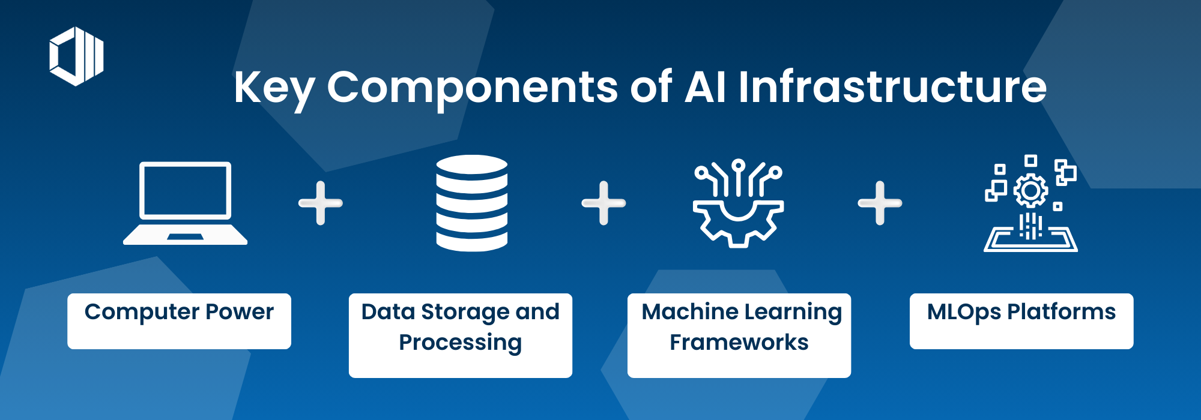
What is AI Infrastructure
AI Infrastructure refers to the integrated system of hardware, software, and network resources that provides the foundation for developing and deploying artificial intelligence models and applications.
It's the backbone that supports the entire lifecycle of AI solutions, from data preprocessing and model training to deployment and maintenance.

Slide 11
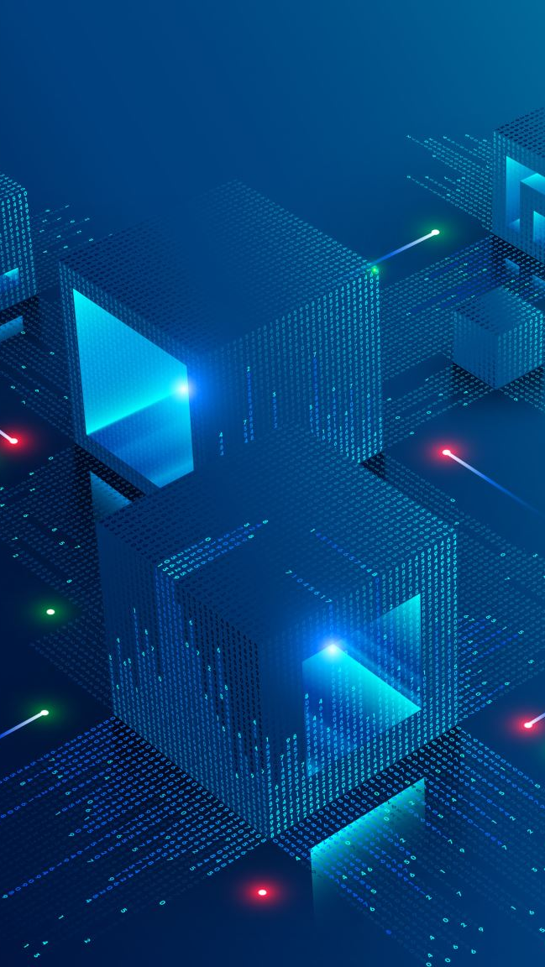
AI Infrastructure
Foundation of AI Projects: AI Infrastructure is critical for the performance, scalability, and efficiency of AI applications, enabling them to process and analyze large datasets, learn from data, and make intelligent decisions.
Enabler of Innovation: A robust AI infrastructure allows organizations to innovate and stay competitive by leveraging the power of AI for improved decision-making, automation, and enhanced customer experiences.

Slide 12
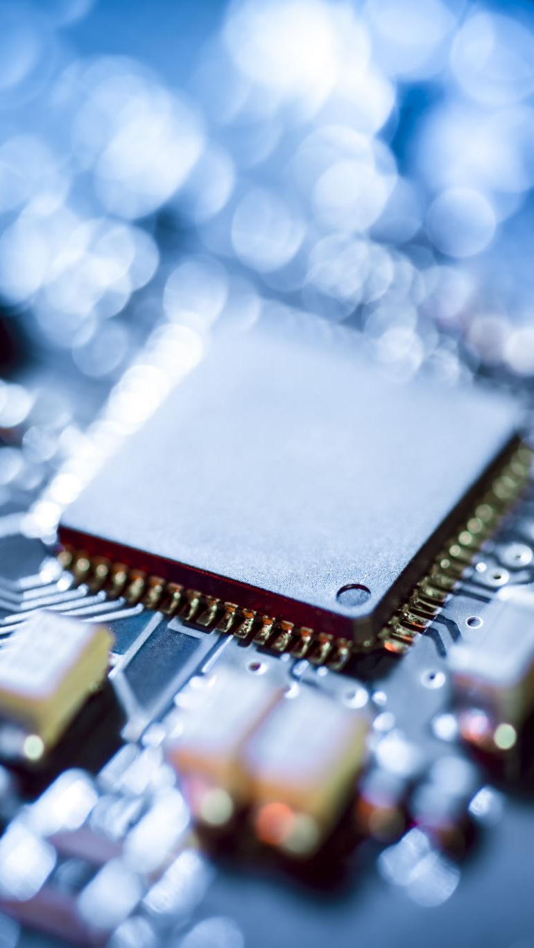
Integrated Systems
It encompasses a range of components, including:
Compute Power: High-performance processors like GPUs (Graphics Processing Units) and TPUs (Tensor Processing Units) that accelerate complex computations required for AI.
Storage: Robust storage solutions to handle vast amounts of data, ensuring it is accessible and secure for AI processing.
Networking: High-speed networks to facilitate swift data transfer and connectivity between different parts of the infrastructure, essential for cloud-based AI solutions and distributed computing.
Software and Frameworks: Specialized AI software and frameworks, such as TensorFlow or PyTorch, that provide the tools and environments necessary for developing and training AI models.

Slide 13
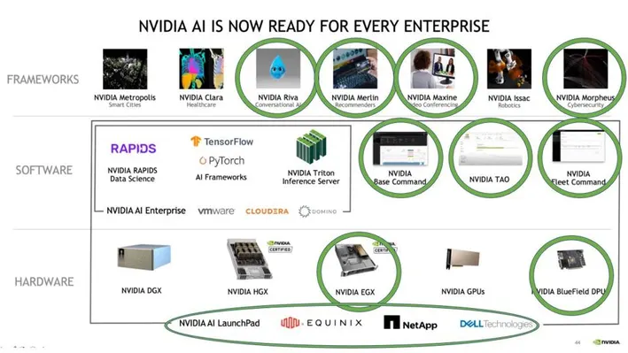
Why is NVIDIA ahead?

